Slide 1
Full Stack Web Development
Git / Getting Started

Slide 2
What Is Git?
Git is a version control system (VCS) used in software development and other version control tasks
Git is aimed at speed, data integrity and support for non-linear workflows
Created by Linus Torvalds in 2005, who is also the creator of Linux
Every Git directory on a computer is a full fledged repository (repo)

Slide 3
What is a Repository?
A repository is an on-disk structure which stores metadata for a set of files and/or directory structure.
A history of changes in the repo
A set of committed objects
A set of references to commit objects

Slide 4
Why Use Git?
Backup files / versions with easy restoration
Work offline – Local repositories
Branching
Collaboration with multiple developers
Moving or adding files

Slide 5
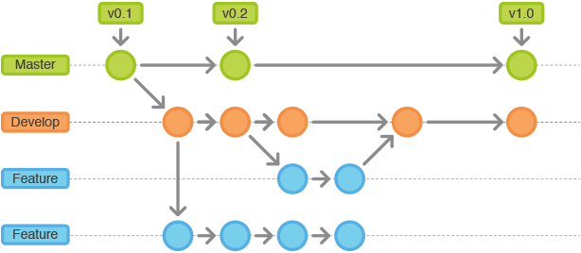
Branching
A branch represents an individual line of development
Serves as an abstraction for the edit/stage/commit process
Branches can be merged with the master branch at any time

Slide 6
Common Git Commands
git init – Creates a local repository
git add <filename>– Adds a file(s) to the index or staging
git rm <filename> – Remove files from index
git status – Get summary of staged files
git commit – Record changes to the repo. Takes log message
git clone /path/to/repo – Clones a repo to your machine
git push origin master – Push to remote repo (master branch)
git checkout –b <branchname> - Create and switch to new branch
git merge <branchname> - Merge different branch into active one
git config --global user.name "Sam Smith“ – Configure name to use with commits
git config --global user.email sam@example.com – Configure email

Slide 7


